Slide 1
Current and Future Therapeutic Management of Retinal Disease
Oren Plous, MD FACS
Gulf Coast Retina Center

Slide 2
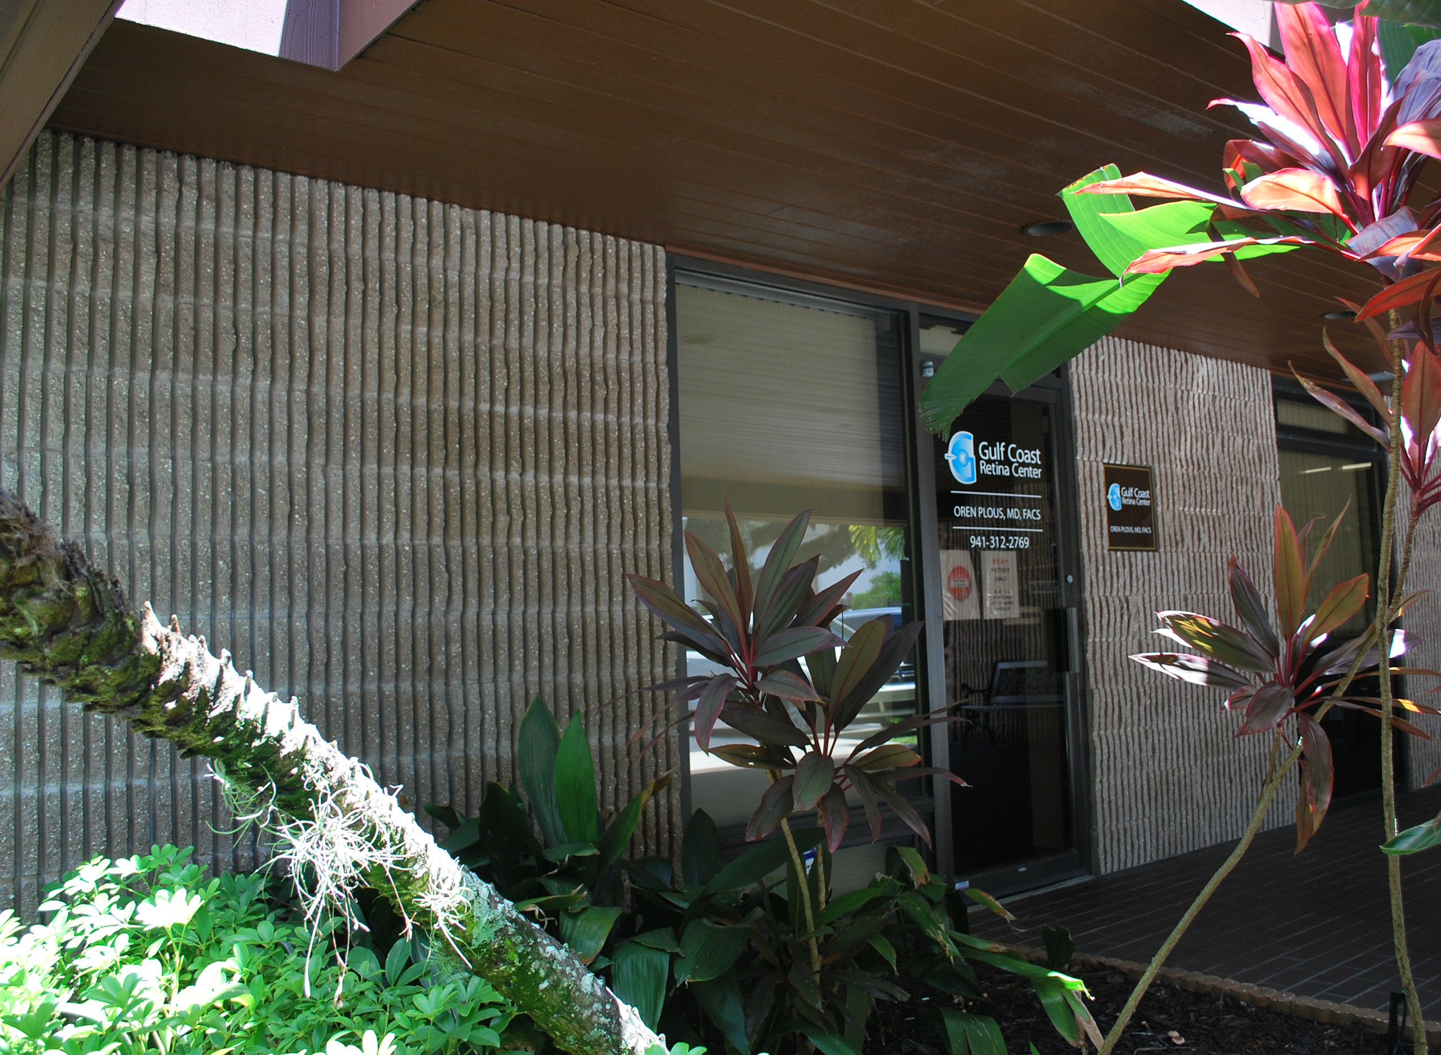
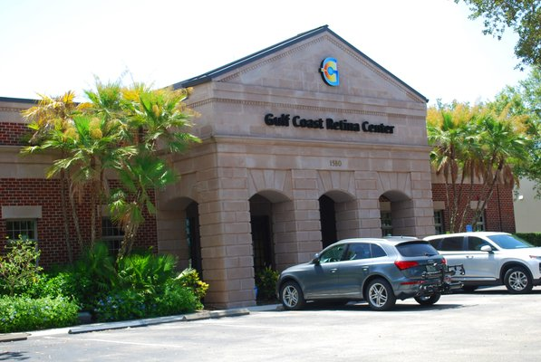
Gulf Coast Retina Center
2 Offices:
Sarasota: 1961 Floyd Suite B – next to Sarasota Memorial
Venice: 1580 Jacaranda

Slide 3
Oren Plous MD, FACS
Financial Disclosures: None

Slide 4
Types of Retinal Disease
Macular Degeneration (Wet/Dry)
Diabetic Retinopathy (Non and Proliferative)
Macular Pattern Dystrophies
Retinal Vascular Disease
Hereditary Diseases of the Retina

Slide 5
Let’s Ask Chat GPT:
What is the global prevalence and burden of retinal disease?

Slide 6
The prevalence and burden of retinal diseases can vary significantly depending on the specific condition and the region of the world. Retinal diseases encompass a wide range of disorders that affect the retina, the light-sensitive tissue at the back of the eye. Some of the most common retinal diseases include age-related macular degeneration (AMD), diabetic retinopathy, retinal detachment, retinitis pigmentosa, and glaucoma, among others.
Age-Related Macular Degeneration (AMD): AMD is a leading cause of vision loss among older adults. The global prevalence of AMD increases with age, with higher rates in individuals over 60 years old. AMD has a significant burden on individuals and healthcare systems due to its impact on central vision
.
Diabetic Retinopathy: Diabetic retinopathy is a complication of diabetes and is a leading cause of blindness in working-age adults. The prevalence of diabetic retinopathy is directly related to the duration of diabetes, glycemic control, and other factors. As the prevalence of diabetes increases worldwide, so does the burden of diabetic retinopathy.
Retinal Detachment: Retinal detachment is a relatively less common condition but requires urgent medical attention. Its prevalence may vary based on factors like age, myopia (nearsightedness), and trauma.
Retinitis Pigmentosa: Retinitis pigmentosa is a rare genetic disorder that leads to progressive vision loss.
Its prevalence varies among populations, and it is estimated to affect around 1 in 4,000 people worldwide.
Glaucoma: While glaucoma primarily affects the optic nerve, it can also have a significant impact on the retina.
Glaucoma is a leading cause of irreversible blindness worldwide. Its prevalence varies with age, ethnicity, and other factors.
The global prevalence and burden of retinal diseases are influenced by several factors, including population demographics, access to healthcare, awareness, and advances in medical technology and treatments. To obtain the most up-to-date and region-specific information on the prevalence and burden of retinal diseases, it is advisable to consult recent epidemiological studies and data from healthcare organizations and governmental agencies. Additionally, advancements in research and healthcare may have led to changes in these statistics since my last knowledge update in September 2021.

Slide 7
Current Therapeutic Approaches
Common treatment modalities for retinal diseases to include:
Anti-vascular endothelial growth factor (anti-VEGF) therapy (injections/surgical implants) for neovascular age- related macular degeneration
Laser therapy (“hot and cold”) for retinal disease
Intravitreal injections for dry macular degeneration
Gene therapy (LCA RPE65)
Steroids (Topical/Subtenon’s/Intravitreal)
Na/K pump inhibitors (e.g. acetazolamide/Dorzolamide)
Aldosterone Blockers (e.g. Eplerenone/Spironolactone)

Slide 8
Limitations of Current Therapies
Duration of therapeutic effect
Discomfort and fear of treatments
Risk of infection or other complications
Patient compliance – voluntary and involuntary

Slide 9
Gene Therapy for Retinal Disease
Hey Chat, give us a hand on this one buddy, ok?

Slide 10
“Gene therapy is a revolutionary approach to treating various diseases, including retinal diseases, by modifying the genetic material within cells to correct or replace faulty genes. In the context of retinal diseases, which affect the light-sensitive tissue at the back of the eye (retina and choroid, oversimplification), gene therapy holds great promise for both inherited and acquired conditions that can lead to vision loss or blindness.
Here is an overview of gene therapy and its potential for treating retinal diseases:
What is Gene Therapy?
Gene therapy involves the introduction, alteration, or replacement of genetic material within a patient's cells to treat or prevent a disease. This can be achieved by delivering therapeutic genes, editing existing genes, or silencing harmful genes.

Slide 12
Types of Retinal Diseases Treated with Gene Therapy:
Gene therapy has shown promise in treating various retinal diseases, including:
Retinitis Pigmentosa (RP): A group of inherited diseases causing gradual vision loss.
Leber Congenital Amaurosis (LCA): A severe inherited retinal disorder often leading to blindness in childhood.
Age-Related Macular Degeneration (AMD): An acquired disease affecting the macula, leading to central vision loss in the elderly.
Stargardt Disease: An inherited juvenile macular dystrophy causing progressive vision impairment.
Mechanisms of Gene Therapy for Retinal Diseases:
Gene Replacement Therapy: Healthy copies of the defective gene are introduced into the affected cells to restore normal gene function.
Gene Editing: Technologies like CRISPR-Cas9 are used to precisely edit the
faulty genes within the retina.
Gene Silencing: Small RNA molecules, like RNA interference (RNAi), can
be used to inhibit the expression of harmful genes.
safety and efficacy.

Slide 13
Delivery Methods:
Viral Vectors: Most commonly, modified viruses (e.g., adeno-associated viruses, AAVs) are used as carriers to deliver therapeutic genes into retinal cells.
Non-viral Vectors: Lipid nanoparticles and other non-viral delivery methods are also under investigation.
Clinical Successes:
One of the most significant successes in retinal gene therapy is Luxturna, approved by the FDA in 2017 to treat a form of LCA. It is delivered via AAV and has restored some vision in patients.
Several other gene therapy clinical trials for retinal diseases have shown promising results, with ongoing research to improve safety and efficacy.
Challenges and Considerations:
Safety concerns, including potential immune responses to viral vectors.
Long-term effectiveness and durability of gene therapy.
High costs associated with developing and administering gene therapies.
Future Directions:
Continued research into optimizing delivery methods, safety, and efficacy.
Exploration of combination therapies and personalized approaches.
Potential expansion of gene therapy applications to other retinal and eye-related disorders.

Slide 14
OK, not bad Chat, thanks!

Slide 15
So Chat, tell us about Stem Cell Therapy?
Stem cell therapy is a promising approach for treating retinal diseases, offering the potential to restore damaged or degenerated retinal tissue and improve vision. Here's an overview of stem cell therapy for retinal diseases:
Types of Stem Cells:
Embryonic Stem Cells (ESCs): Derived from embryos, these pluripotent stem cells can develop into any cell type in the body. (controversial)
Induced Pluripotent Stem Cells (iPSCs): Adult cells (e.g., skin cells) are reprogrammed to become pluripotent, similar to ESCs.
Adult Stem Cells (or Tissue-Specific Stem Cells): These are found in various tissues, including the eye, and have limited differentiation potential.
Applications in Retinal Disease:
Stem cell therapy can potentially treat a range of retinal diseases, including age-related macular degeneration (AMD), retinitis pigmentosa (RP), Stargardt disease, and diabetic retinopathy.
The goal is to replace or repair damaged retinal cells, particularly photoreceptor cells (rods and cones), which are crucial for vision.

Slide 16
Mechanisms of Action:
Replacement: Stem cells can differentiate into retinal cells and integrate into the existing retinal tissue.
Paracrine Effects: Stem cells can release factors that promote the survival and function of existing retinal cells.
Clinical Progress ; Numerous clinical trials have been conducted or are ongoing to evaluate the safety and efficacy of stem cell-based therapies for retinal diseases.
Positive results have been reported in some trials, with improvements in visual acuity and retinal function observed in certain patients.
Challenges and Considerations:
Safety Concerns: There are potential risks, such as tumorigenesis when using ESCs or iPSCs, and immune responses.
Differentiation Efficiency: Ensuring that stem cells differentiate into the desired retinal cell types is crucial for successful therapy.
Long-term Efficacy: The durability of improvements in vision and the need for repeated treatments are still being studied.
Ethical Considerations: The use of ESCs raises ethical concerns related to the destruction of embryos.
Future Directions: Continued Research: Ongoing studies are focused on refining stem cell-based therapies, optimizing protocols, and enhancing safety.
Personalized Medicine: Tailoring treatments to individual patients based on their specific retinal conditions and genetics and combination therapies: Combining stem cell therapy with other approaches, such as gene therapy or pharmaceuticals, to enhance outcomes.

Slide 17
Other Promising Areas of Research:
Neuroprotection and Regeneration
Artificial Intelligence in retinal Disease Management
Nanotechnology Delivery Systems
Immunotherapy and Anti-Inflammatory Approaches (Syfovre®, Izervay® for Advanced Dry AMD)
Combination Therapies (Vabysmo®)

Slide 18
Clinical Trials and Regulatory Considerations
Importance of clinical trials in evaluating novel therapeutic interventions
Regulatory considerations for approval and commercialization of retinal disease treatments
Ongoing clinical trials in retinal disease research
Clinicaltrials.gov

Slide 19
Patient Perspectives and Quality of Life
Impact of retinal diseases on patients' quality of life
Importance of patient-centered care and holistic approach
Support groups and resources for patients with retinal diseases
Healthcare Economics and Access to Treatment
Economic burden of retinal diseases on healthcare systems
Accessibility and affordability challenges for patients
Importance of health policies and reimbursement strategies
Ethical Considerations
Ethical challenges in retinal disease research and treatment
Balancing the benefits and risks of emerging therapies
Informed consent and privacy concerns
Collaboration and Interdisciplinary Approaches
Importance of collaboration between researchers, clinicians, and industry
Interdisciplinary approaches to accelerate therapeutic advancements

Slide 20
Is anybody still awake?

Slide 21
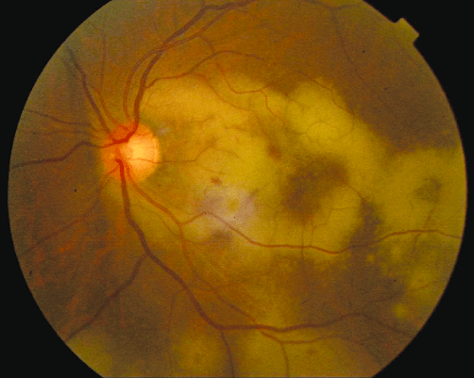
So let’s change things up a bit and talk about some new (and older) therapies we now use for various diseases. And some retina “PORN” (no, not Progressive Outer Retinal Necrosis, though I have, amazingly, had a couple of cases come thru the clinic recently).

Slide 22
Anti-vegf History For Retinal Disease
Macugen (RNA aptamer to block VEGF - 2004
Avastin/Lucentis – 2006 First drugs to have good efficacy in treating wet AMD. Found also to be effective in treating other retinal disorders such as Dibaetic Retinopathy and Vascular Occlusive Disease as well as (sometimes) idiopathic CME
.
Eylea - My personal favorite
Beovue – Inflammation considerations
Vabysmo – combination therapy (Anti-vegf and Ang 2 inhibitor)
Biosimilars
Eylea HD (2mg vs 8 mg)

Slide 23
New Treatments for Advanced Dry AMD
Both work on the compliment pathway
Both reduced advancement of geographic atrophy
Both double the risk of developing wet AMD
Syfovre targets C3, no effect on vision
Izervay targets C5, reduces the risk of vision loss by 56% at 12 months

Slide 24
Other commonly used treatment used in clinic:
Dorzolamide® for CME in RP patients (no leakge on FA)
Photodynamic therapy for intractable Central Serous Retinopathy – low fluence
Steroids for inflammation and CME
Subtenon’s route more effective than topicals
Diabetic issues
IOP issues

Slide 25
Let’s talk a little about the macula:
One of the hardest clinical decisions can be differentiating between Central Serous Retinopathy (CSR) and wet AMD.
High resolution OCT can really help differentiate the two (as well as OCTA and/or FA).

Slide 26
OCT Retinal Segmentation The 4 Lines

Slide 27
Affected Eye:

Slide 28
Other eye, same patient:

Slide 29
Can you identify what is missing to feel confident that this case is not AMD?

Slide 30
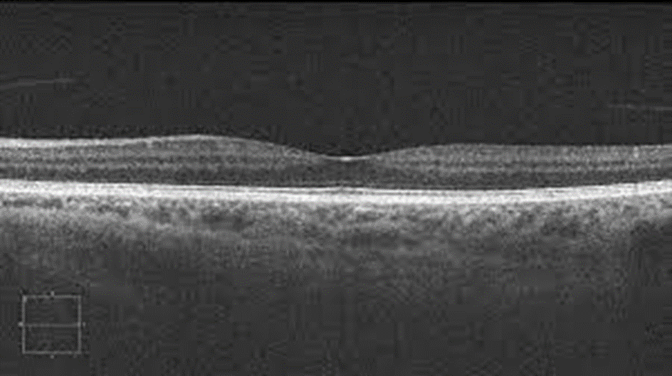
No Drusen!!
Other eye, same patient

Slide 31
But the plot thickens…look closer
Is this a type 1 CNV? And how can we differentiate it?

Slide 32
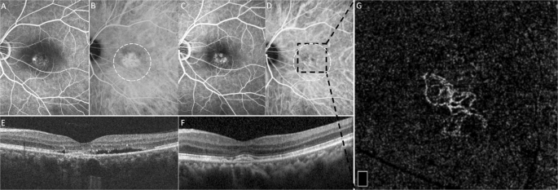
We can use OCTA
Look for a net on OCTA at the level of the RPE-RPE fit
Again, no drusen, right?

Slide 33
What about chronic CSR vs. Dry AMD?
Again, look for presence or absence of drusen
And…get an FAF

Slide 34
Ultrawidefield FAF
Notice the “guttering”

Slide 35
How about Pattern Dystrophies vs. Dry AMD
This can be a tough one also
Again, look for drusen
And, RPE migration right thru the ellipsoid zone (very cool)

Slide 36
Drusen in Dry AMD Patient

Slide 37
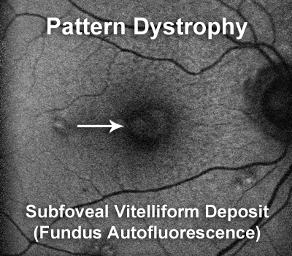
AOFPED
Notice that the subfoveal lesion is above (anterior) to the RPE

Slide 38
Pattern Dystrophy
Unlike typical dry macular degeneration where the buildup of material is below the retinal pigment epithelium, in pattern dystrophy, the buildup of material is above the pigment epithelium and directly beneath the retina (asterisks).

Slide 39
Geographic Atrophy (Advanced Dry AMD)

Slide 40
Conclusion
Current and emerging treatments are making a huge difference in patient lives.
There is a real need and emphasis for continued research and innovation
The goal is to have a wider choice of options with better outcomes for our patients.

Slide 41
Thank you!!!
Oren Plous, MD, FACS

