Slide 1
Current and Future Modalities for the Diagnosis and Management of Retinal Disease
Oren Plous, MD FACS
Gulf Coast Retina Center

Slide 2
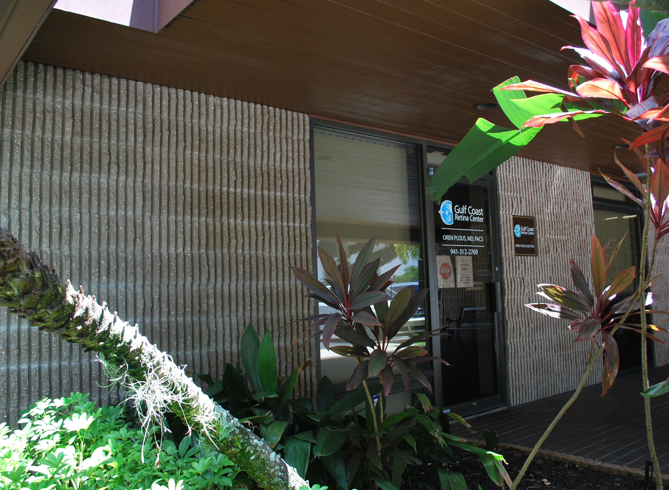
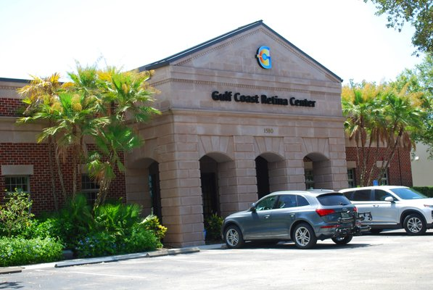
Gulf Coast Retina Center
2 Offices:
Sarasota: 1961 Floyd Suite B – next to Sarasota Memorial
Venice: 1580 Jacaranda

Slide 3
Oren Plous MD, FACS
Financial Disclosures: None

Slide 4
Objective of this Presentation
To explore the current and future diagnostic modalities for retinal disease in office settings

Slide 5
Diagnostic Methods Used In A Retina Practice
The usual suspects - common:
Visual Acuity Testing: Snellen, ETDRS
Color Plate Testing (Ishihara, Farnsworth)
Direct visualization: Slit lamp, BIO
Fundus Imaging: Color photos, Fluorescein Angiography (FA)
Retinal Cross-Sectional Imaging: Time Domain OCT, Ultrasound (A/B)
Less Common:
Indocyanine Green (ICG) Angiography
Fundus Auto Fluorescence
OCT Angiography, Swept Source OCT
ERG Testing, EOM Testing
Ultra Wide Field Imaging (Optos, Zeiss)

Slide 6
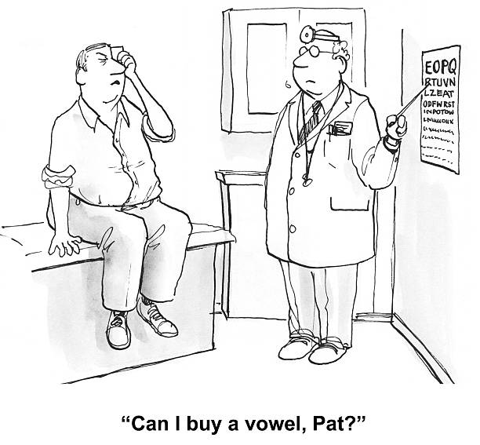
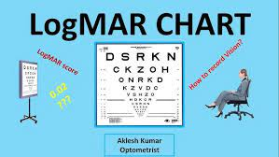
Visual Acuity Testing
All familiar, is the basis of our trade:
Snellen, Sloan:
ETDRS:
ETDRS stands for Early Treatment Diabetic Retinopathy Study. The ETDRS test is designed to eliminate inaccuracies in the Snellen and Sloan tests
ETDRS charts were theoretically superior to Snellen charts because interpatient differences were more accurately measured and longitudinal follow-up measurements had more consistent precision, regardless of whether the patients had high or low levels of visual acuity.

Slide 7
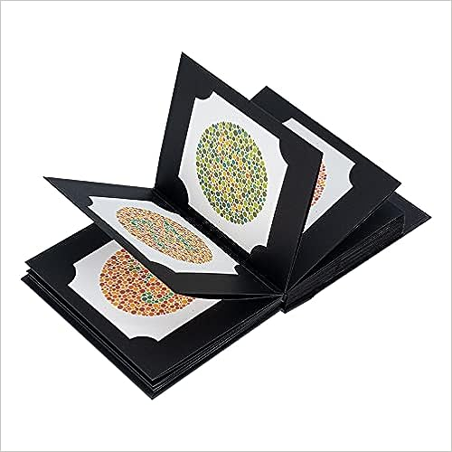
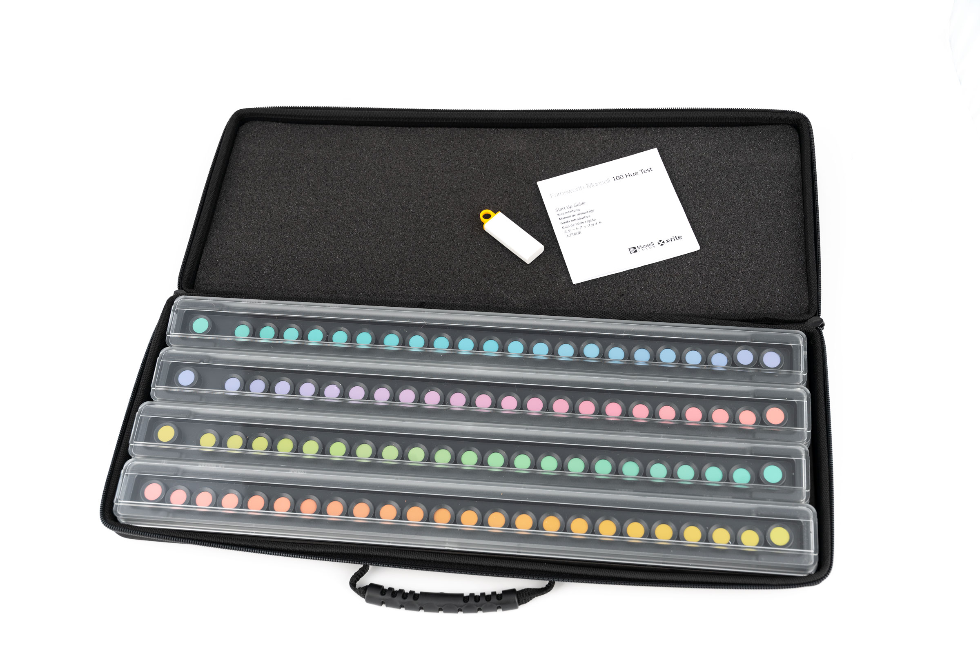
Color Plate Testing
Ishihara
Farnsworth-Munsell
We are all familiar with these tests. I use the Ishihara as a screen not just for color blindness but also to diagnose subtle cone and rod dystrophies (variable dyschromatopsia), which can have a surprisingly wide spectrum of individual penetrance.

Slide 8
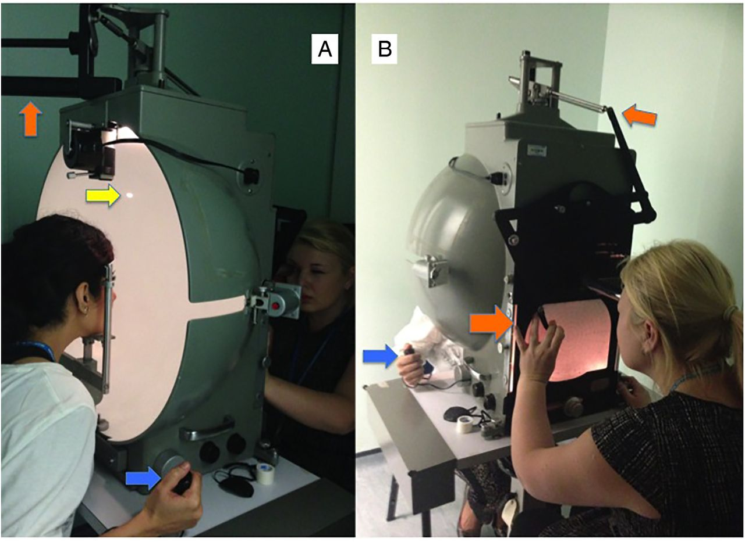
Visual Field Testing
Humphrey vs. Goldmann
Goldmann Visual Field
Loved by neuro ophthalmologists
Very tedious
10-2 Humphrey Visual Field (HVF)
Plaquenil screening
24-2 HVF
Retinal vascular occlusions, Retinitis pigmentosa and other retinal dystrophies, central stroke
30-2 HVF
Best for wide field analysis, can be cumbersome

Slide 9
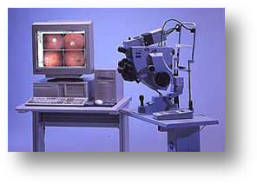
Color Fundus Photography
Color fundus photography has been a mainstay of retina practice for years. With the transition from film to digital systems, instant evaluation became possible.
Wide field sweeps were available but could be tedious to perform
Zeiss FF450
digital fundus camera

Slide 10
Ultrawide Field Imaging (UWF)
Ultrawide field imaging became popular 10-15 years ago. Many optometrists were early adopters.
When retina specialists realized we could get not just wide field color photos but also FA and ICG angiography, we finally got it thru our thick heads what a great and valuable tool UWF is.
An experienced photographer can get waaay out in the periphery and pick up subtle retinal pathology that is easily missed, especially in advanced phakic patients or other patients in which the media is difficult to see thru
Patients (and family) also greatly appreciate actually seeing their pathology instead us trying to explain
what is going on (a picture tells a thousand words).
I have an Optos in every office that I see patients.

Slide 11
Fluorescein Angiography (FA) and Indocyanin Green Angiography (ICGA)
Both are used for retinal vascular imaging. Can be injected (via different syringes) near simultaneously.
Fluorescein is a smaller molecule and therefore easily escapes the “leaky” choriocapillaris where ICG is a larger molecule and will stay within intact choriocapillaris vessels.
Imaging is captured by exciting each molecule at one wavelength (FA @ 490nm, ICG @ 780nm) and capturing the resulting excitation at another wavelength (FA @ 520nm, ICG @ 805nm) via filters in the imaging system.

Slide 12
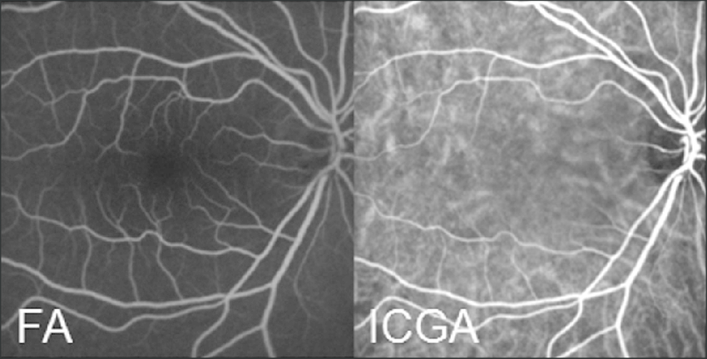
FA vs. ICG
I use both in clinical practice, though ICG studies are not as necessary and therefore not as common.
Summary: ICG allows for visualization of choroidal vessels as well as retinal vessels whereas FA only allows for retinal vessel imaging.

Slide 13
Electroretinography (ERG)
The gold standard for diagnosing Cone, Cone-Rod, Rod-Cone, and Rod Dystrophies.
There are 3 main types of ERGs: full-field flash ERG (ffERG), pattern ERG (PERG), and multifocal ERG (mfERG). Each has different applications and benefits:
- In full-field ERG (ffERG), electrodes record the summed electrical response of the retinal cells. The summed electrical response is a blend of the results from a range of different cells and regions in the retina, meaning that full-field ERG (ffERG) shows the status of the retina as a whole.
- In Pattern ERG (PERG), the light stimulus is an alternating checkerboard pattern which evokes electrical responses from the ganglion cells composing the inner retina. PERG is commonly used as a test for disorders affecting ganglion cells, as well as many neurodegenerative disorders.
- Multifocal ERG (mfERG) is performed with a similar protocol to the PERG, but the light
stimulus displays an array of hexagons that flicker between white and black in a
pseudo-random sequence. The mfERG is best for measuring dysfunction of the central
retina area and is not sensitive to abnormalities in the ganglion axon.

Slide 14
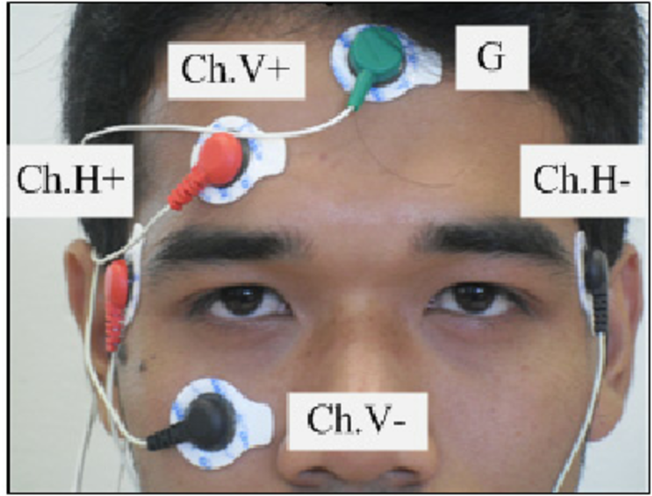
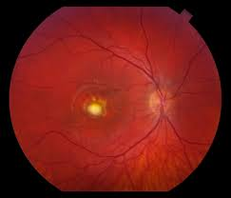
Electrooculogram
The electrooculogram (EOG) is an electrophysiologic test that measures the existing resting electrical potential between the cornea and Bruch's membrane.
Think of one disease: Best’s Disease

Slide 15
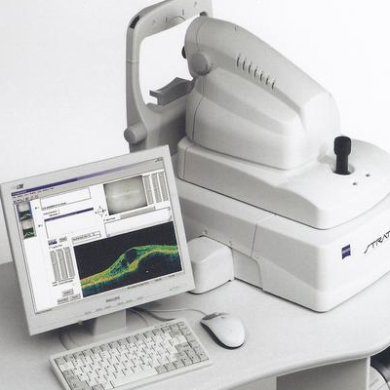
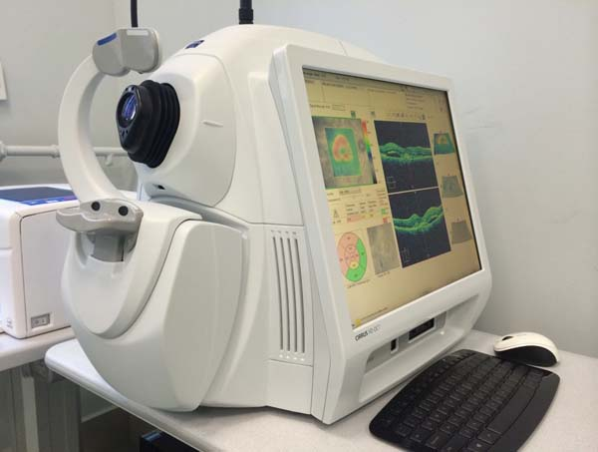
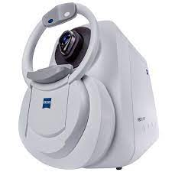
Optical Coherence Tomography (OCT)
Optical Coherence Tomography (OCT) is a non-invasive diagnostic technique that renders an in vivo cross-sectional view of the retina. OCT utilizes a concept known as interferometry to create a cross-sectional map of the retina.
Application in clinical practice begun around 1991 (yes, that far back!).
Three major types – Time Domain, Spectral Domain, and Swept Source.
Time Domain: Initial systems available commercially. Time domain systems acquire approximately 400 A-scans per second using 6 radial slices oriented 30 degrees apart. Because the slices are 30 degrees apart, care must be taken to avoid missing pathology between the slices. E.g. Zeiss Stratus.
Spectral Domain: Spectral-domain technology scans approximately 20,000-40,000 A-scans per second. This increased scan rate and number diminishes the likelihood of motion artifacts, enhances the resolution, and decreases the chance of missing lesions. Spectral-domain systems increase the signal-noise ratio by image-averaging multiple B-scans at the same location. Whereas most time domain OCTs are accurate to 10-15 microns, spectral domain machines may approach 3-micron resolution. Whereas most time domain OCTs image 6 radial slices, spectral domain systems continuously image a 6mm area. This diminishes the chance of inadvertently missing pathology. Spectral-domain systems typically operate at 800-870 nm wavelengths, although longer wavelengths of 1050-1060 nm are being developed for deeper penetration in the tissue.
Swept Source: Swept-source technology, uses a wavelength-sweeping laser and dual-balanced photodetector, allowing for faster acquisition speeds of 100,000-400,000 A-scans per second.
This technology uses longer wavelengths of 1050-1060 nm for deeper tissue penetration and
provides enhanced axial resolution. The enhanced axial resolution along with the faster scanning speeds, which allows for greater image averaging, improves image quality and the ability to visualize deeper structures in more detail.

Slide 16
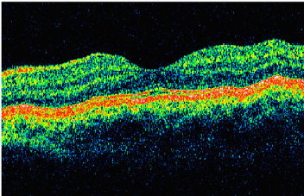
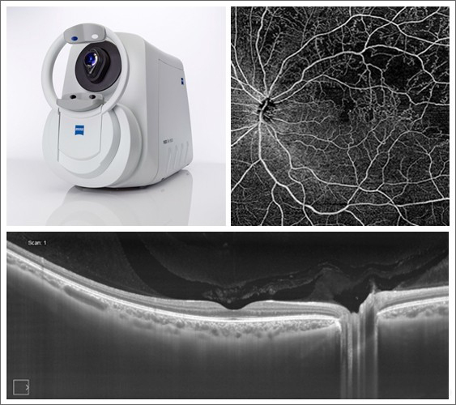
OCT Type Images
Zeiss Stratus Time Domain OCT
Zeiss Cirrhus Spectral Domain OCT
Zeiss Plex Elite Swept Source OCT

Slide 17
Retinal Segmentation on High Resolution OCT

Slide 18
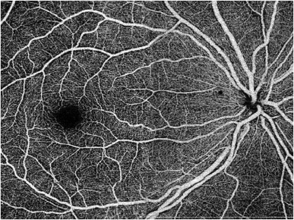
OCT Angiography (OCTA)
Most recently, both spectral domain and swept source OCT have been used to generate non-invasive non-dye-based OCT angiography (OCTA)[1] images. In brief, OCT angiography uses motion contrast by comparing the decorrelation signal between multiple B-scans obtained at each retinal cross-section to detect blood flow, employing the principle that theoretically only circulating erythrocytes within the retinal capillaries should be moving in the retina.

Slide 19
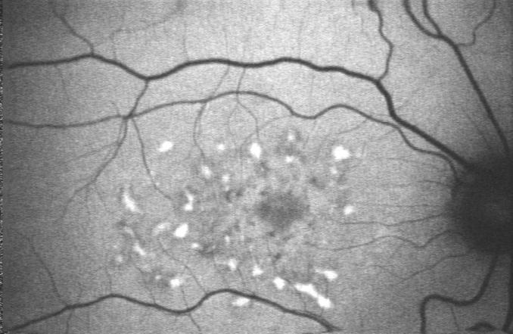
Fundus Autoflourescence
Fundus autofluorescence (FAF) is a non-invasive imaging modality that can map naturally and pathologically occurring fluorophores in the posterior pole. FAF was first utilized for in vivo fundus imaging in 1995 Over time there have been many technological advancements that have allowed for the development of numerous commercially available FAF devices, with each device offering a unique set of advantages and disadvantages based on the imaging type utilized, the excitation wavelength employed (e.g. green short-wavelength, blue short-wavelength, near-infrared) and the field of view desired.Unlike fluorescein angiography, FAF does not require the injection of a fluorescein dye in order to image the retina, but rather utilizes the fluorescent properties of lipofuscin within the retinal pigment epithelium (RPE) to create an image

Slide 20
Artificial Intelligence (AI) in Retinal Disease Diagnosis
Per Chat GPT last night:
“The future of artificial intelligence (AI) in retinal disease diagnosis is promising and holds great potential for improving the accuracy, efficiency, and accessibility of diagnosing various eye conditions. Here are some key trends and developments to expect:

Slide 21
AI Future In Diagnosis of Retinal Disease: Chat GPT Conversation
Early Detection and Diagnosis: AI algorithms can analyze retinal images and scans with high precision, allowing for the early detection of retinal diseases such as diabetic retinopathy, age-related macular degeneration, and glaucoma. Early diagnosis is crucial for effective treatment and preventing irreversible vision loss.
Telemedicine and Remote Screening: AI-powered retinal disease diagnosis can enable telemedicine and remote screening programs. Patients can capture retinal images using smartphones or portable devices, which can then be analyzed by AI algorithms. This approach enhances access to eye care, particularly in underserved or remote areas.
Personalized Treatment Plans: AI can help ophthalmologists tailor treatment plans based on individual patient data. By considering a patient's unique retinal characteristics, AI can assist in recommending the most appropriate treatment options and monitoring disease progression over time.
Improved Accuracy and Consistency: AI systems are capable of processing vast amounts of data quickly and consistently. They can identify subtle changes in retinal images that may be missed by the human eye, leading to more accurate diagnoses and better tracking of disease progression.
Reducing Healthcare Costs: AI-driven retinal disease diagnosis can help reduce healthcare costs by streamlining the diagnostic process, minimizing unnecessary tests, and optimizing resource allocation. Early intervention can also lead to cost savings by preventing advanced stages of retinal diseases.

Slide 22
Chat GPT Discussion - cont.
Integration with Electronic Health Records (EHRs): AI systems can integrate with EHRs to provide a comprehensive view of a patient's medical history and eye health. This integration can enhance communication among healthcare providers and improve continuity of care.
Research and Drug Development: AI can play a significant role in accelerating research related to retinal diseases. It can analyze large datasets to identify disease patterns, potential risk factors, and therapeutic targets. This can expedite the development of new treatments and drugs.
Ethical and Regulatory Considerations: As AI becomes more integrated into healthcare, ethical considerations around data privacy, bias, transparency, and patient consent will become increasingly important. Regulatory bodies will need to establish guidelines and standards to ensure the safe and responsible use of AI in retinal disease diagnosis.
Continuing Advancements in AI Technology: AI algorithms will continue to evolve and improve in terms of accuracy, speed, and versatility. As hardware and software advancements occur, AI systems will become even more powerful in diagnosing and managing retinal diseases.

Slide 23
Wearable Devices In Retinal Diagnosis Again, per Chat GPT
“Wearable devices for diagnosing retinal diseases are an exciting area of development in healthcare technology. These devices aim to make the process of diagnosing and monitoring retinal conditions more convenient and accessible. Here's a look at current wearable devices and their potential future advancements in this field:
Current Wearable Devices:
Smart Glasses: Some smart glasses are equipped with cameras and display screens that can capture retinal images and display them in real-time. These glasses can assist ophthalmologists during examinations and surgeries by providing a hands-free view of the patient's eye.
Smart Contact Lenses: Researchers are developing smart contact lenses embedded with sensors and tiny cameras. These lenses can continuously monitor changes in the eye and may be used for early detection of retinal diseases like glaucoma or diabetic retinopathy.
Retinal Imaging Devices: Handheld retinal imaging devices, such as fundus cameras and ophthalmoscopes, are becoming more compact and portable. These devices allow for quick and non-invasive imaging of the retina and are particularly useful in telemedicine and remote screening programs.

Slide 24
Chat GPT Wearable Devices Conversation – cont.
Future Developments:
Miniaturization: As technology advances, wearable retinal imaging devices are likely to become even smaller and more discreet. Miniaturized sensors and cameras could be integrated into everyday eyewear or contact lenses, making them less obtrusive for patients.
Real-Time Analysis: Future wearable devices may incorporate AI algorithms that can analyze retinal images in real-time. This would enable immediate detection of abnormalities and faster diagnosis of retinal diseases without the need for specialized medical equipment.
Continuous Monitoring: Wearable devices may offer continuous monitoring of retinal health. This could be particularly valuable for patients with chronic conditions, allowing for early intervention in case of disease progression.
Data Integration: Wearable devices could seamlessly integrate with electronic health records (EHRs) and smartphone apps. This would enable patients and healthcare providers to access and track retinal health data easily, fostering better communication and care coordination.
Telemedicine and Remote Care: Wearable retinal diagnostic devices could play a pivotal role in telemedicine, enabling patients to receive eye care remotely. This is especially important for individuals in remote or underserved areas who may have limited access to specialized eye care.
Therapeutic Applications: Beyond diagnosis, wearable devices may also be developed for therapeutic purposes. For example, devices that provide real-time feedback to help individuals with low vision navigate their environment more effectively.
User-Friendly Interfaces: User experience and ease of use will be a focus in future developments. Wearable retinal diagnostic devices should be designed with patient comfort and usability in mind.

Slide 25
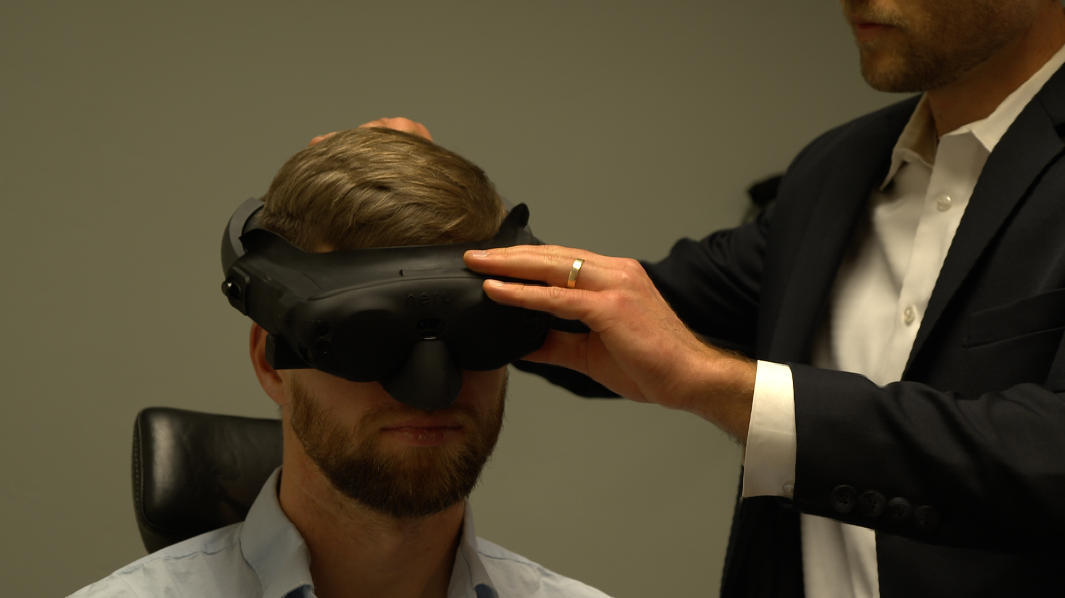
Psssst Chat GPT:
We are already doing it:

Slide 26
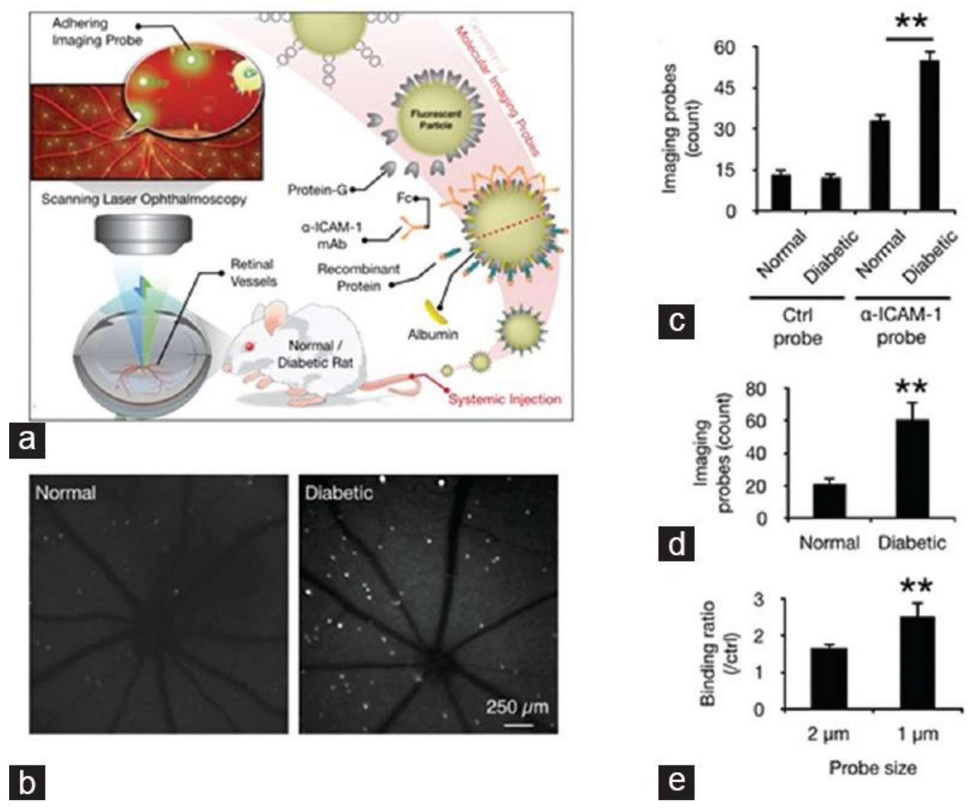
Molecular Imaging
Conventional ophthalmic imaging platforms, such as fundus photography, scanning laser ophthalmoscopy, FA, ICGA, OCT, OCTA are capable of imaging retinal anatomy and morphology with improved resolution. However, an important clinical challenge remains to visualize the early cellular and biochemical processes, which occur before advanced anatomic retinal changes. The aim of molecular imaging techniques is the visualization of molecular processes and functional changes in living animals and human patients before morphological changes occur at the cellular and tissue level. Molecular imaging requires high image resolution, sensitive instrument detection, specific imaging agents, and endogenous molecular probes or exogenous contrast agents that link the imaging signal with a molecular probe or event.
In vivo detection of endothelial injury using molecular imaging. (a) Schematic of in vivo molecular imaging approach; (b) Representative SLO-micrographs from the retinas of normal and diabetic animals. White dots represent firmly adhering probes

Slide 27
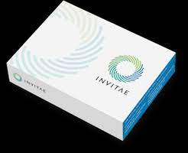
Genetic Testing and Therapy
Advancements in genetic testing and targeted gene therapies for inherited retinal diseases.
Potential for personalized treatment approaches in future.
The Invitae Inherited Retinal Disorders Panel analyzes a saliva sample for genes that are associated with inherited retinal disorders Invitae currently screens, for freeif there is a family history of or clinical signs of related retinal disease.
The first major success for retinal gene therapy was in the treatment of Type 2 LCA, an autosomal recessive IRD that occurs in one in 80,000 births, and is associated with mutations in the GUCY2D, CEP290 and RPE65 genes. Cost $850k per eye.
Others are in the pipeline for Stargardts Disease, Choroideremia, X-linked Retinitis Pigmentosa, X-Linked Retinoschisis, and others.

Slide 28
Advantages of Office Based Diagnostic Modalities
Early detection and intervention
Non-invasive and safe for patients
Cost-effective compared to traditional methods
Improved patient outcomes and quality of life

Slide 29
Limitations and Challenges
Availability and accessibility in certain regions
Training and expertise required for interpretation of complex imaging data
Cost implications for implementation and maintenance
Ethical considerations surrounding the use of AI and patient privacy

Slide 30
Conclusion
Current diagnostic modalities such as OCT, OCT-A, FAF, and ERG have revolutionized retinal disease diagnosis and management in office settings
Future developments hold promising potential, including AI, wearable devices, molecular imaging, and gene therapy
Continued research, innovation, and collaboration are essential for improving retinal disease diagnosis and patient outcomes

